Slide 1


Slide 2
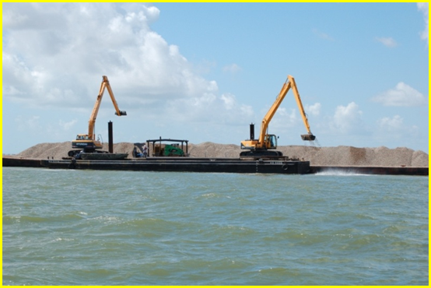
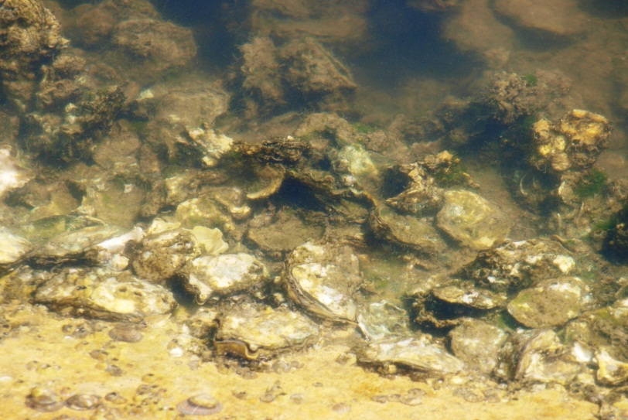
2014-2015 Coastal Fisheries
Scoping Items
Temporary closure of public oyster reefs in:
  East Galveston Bay
  Half Moon Reef, Matagorda Bay

Slide 3
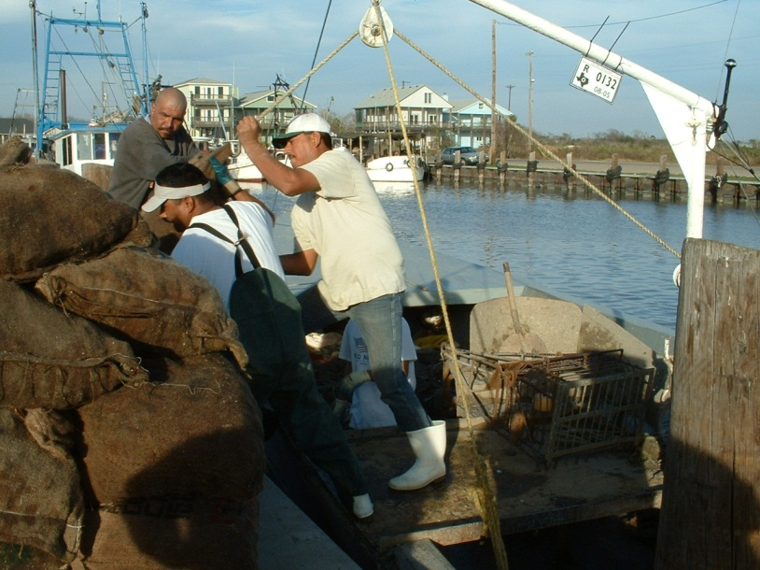
Previous Closure of East Galveston Bay
Approx. 80% of public reefs lost due to Hurricane Ike in September 2008
Closed for two years beginning Sept. 2009
  Allow surviving reefs and restoration activities to recover

Slide 4
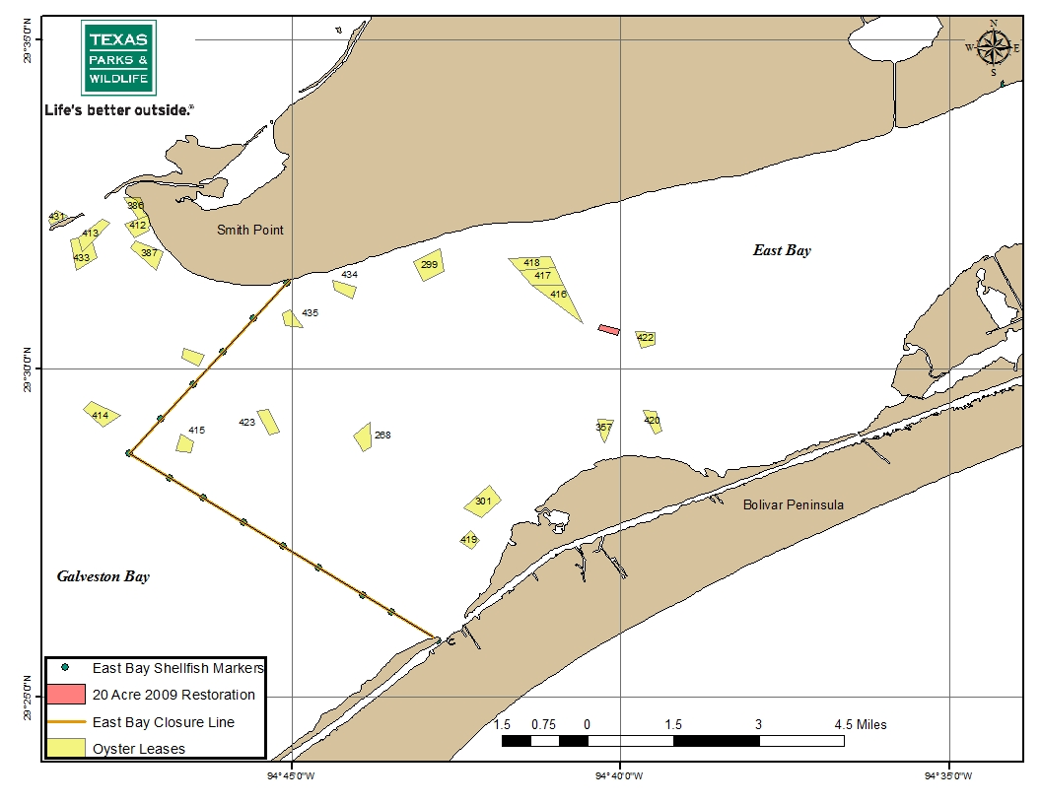
2009-2010 Closure Area

Slide 5
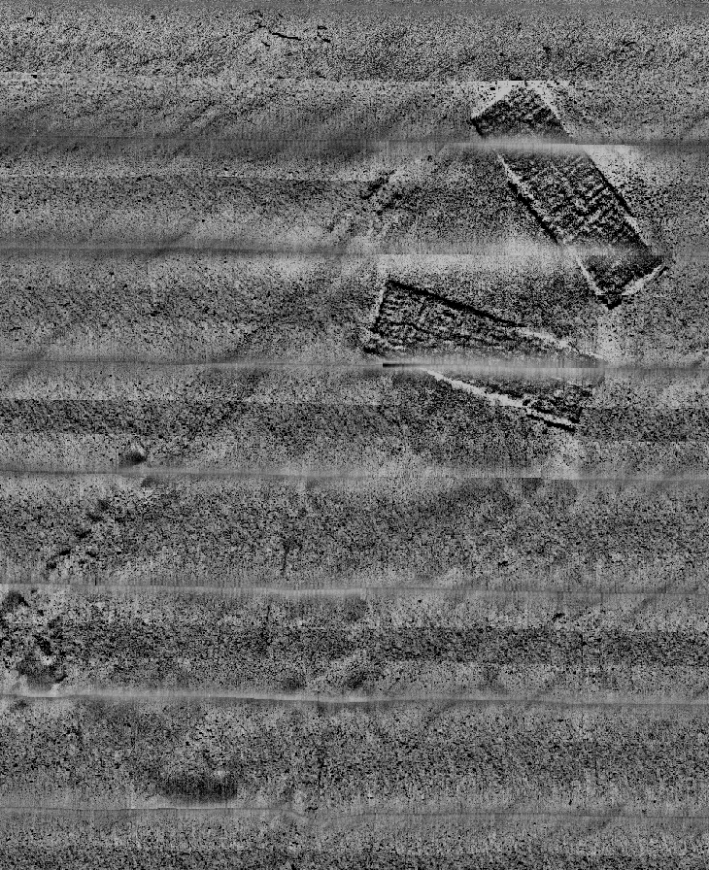
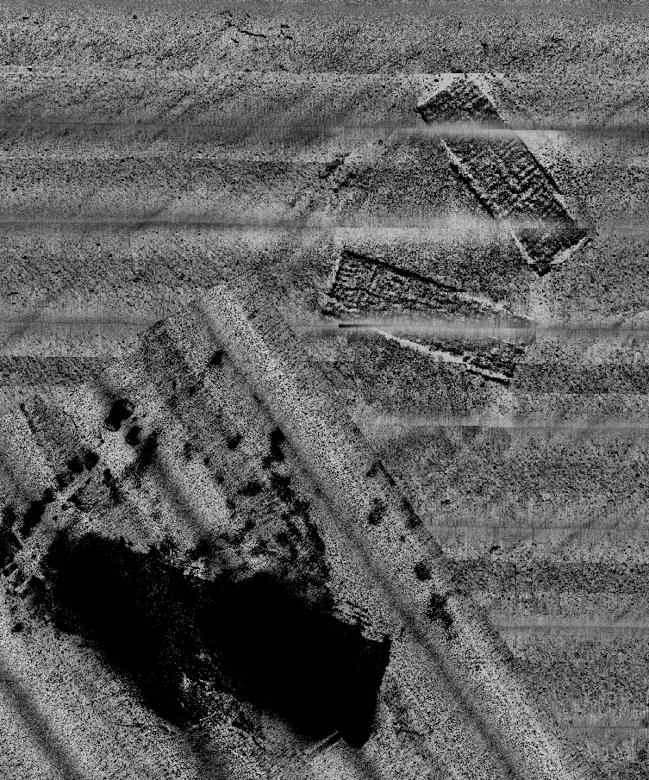
Middle Reef 20 Acre Restoration
Before
After

Slide 6
Oyster Densities on Restored and Control Reefs
*after 2-year closure

Slide 7
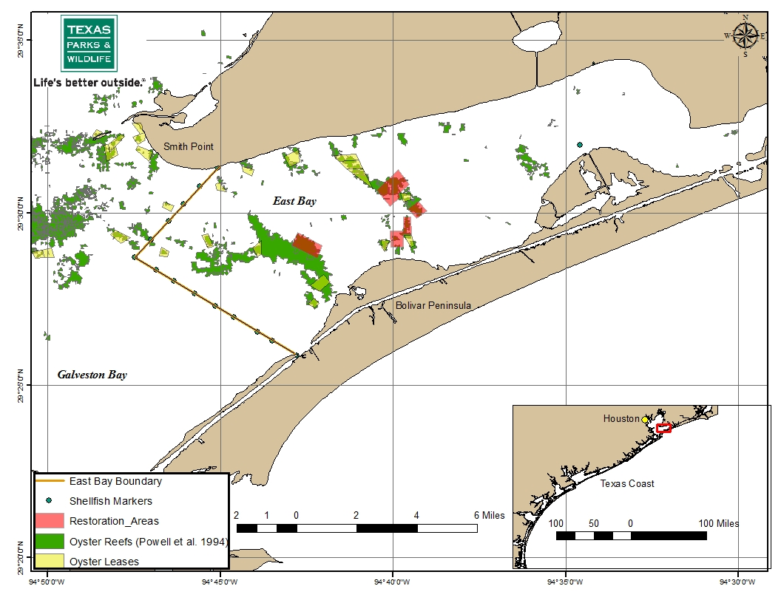
Proposed East Galveston Bay Closure Area

Slide 8
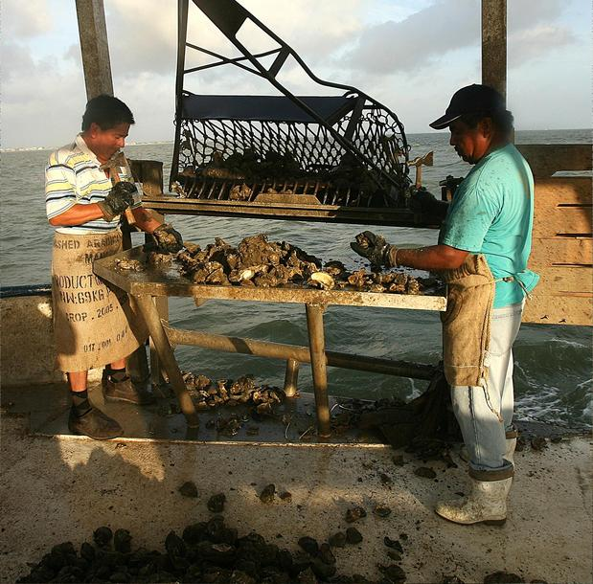
Half-Moon Reef Restoration
Historical oyster reef but no documented production in recent years
  Loss of cultch to storm impacts
  Re-routing of ICWW
  Restoration effort to be conducted by The Nature Conservancy

Slide 9
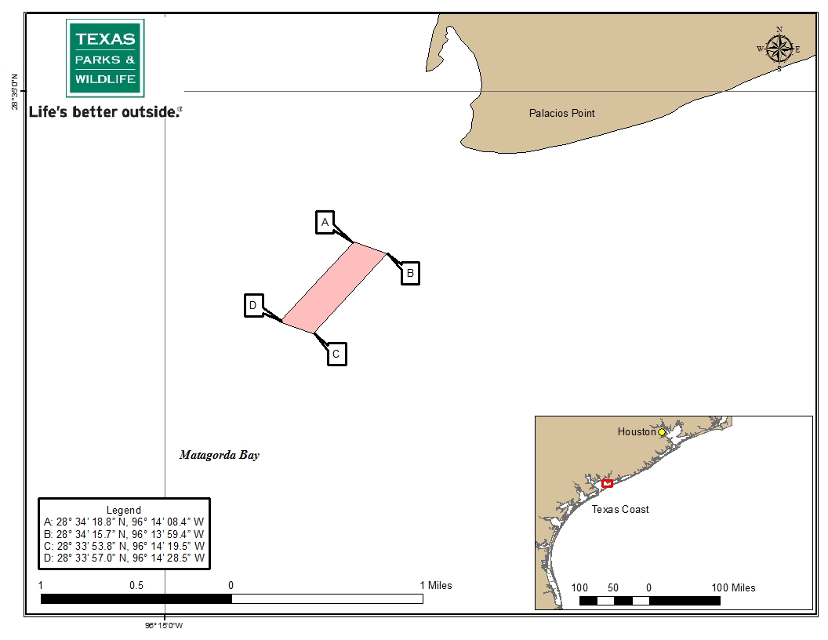
Proposed Half-Moon Reef Closure Area

Slide 10
Oyster Closure Scoping Proposal
Close approved area of East Galveston Bay to the taking of oysters
  Closure boundary will be same as 2009-2011 closure boundary
Close approved area of Half Moon Reef, Matagorda Bay to the taking of oysters.
  Closure boundary will be marked with buoys and maintained by TNC

Slide 12
Status of Southern Flounder Along the Texas Coast

Slide 13
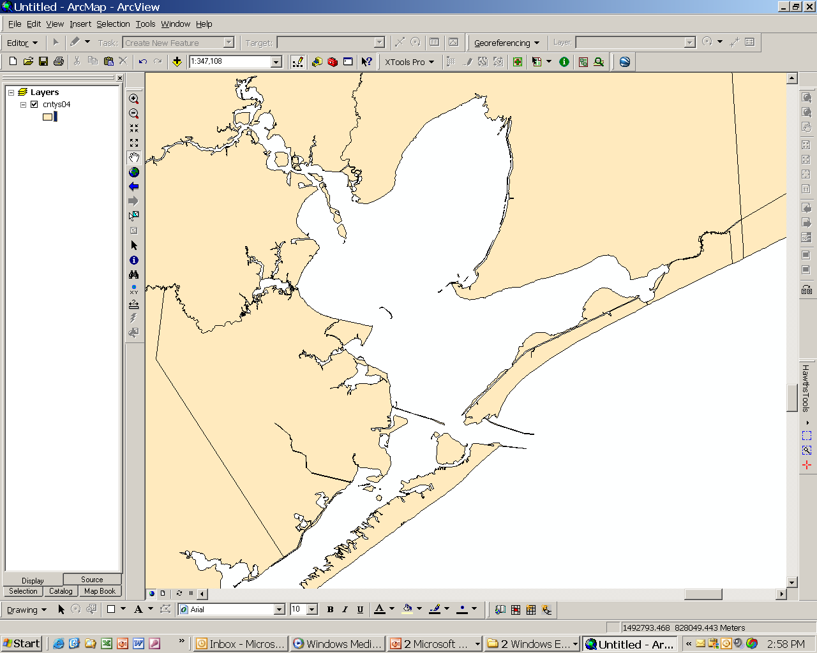
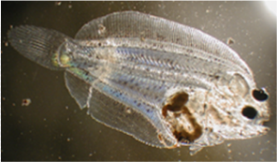
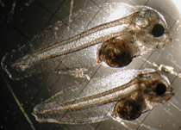
Southern Flounder Life History
Adults migrate offshore to spawn Oct-Dec (some stay in the bays).
Larvae settles. Juveniles move to deeper areas of bays.
Adults (ages 2+) spawn offshore (50-100 ft).
Larvae drift into the bays with currents.
Adults return gradually during the spring.
Females produce pelagic, buoyant eggs – males fertilize.
Gulf of Mexico

Slide 14
History of Flounder Regulations
1980 – Monofilament nets banned
1988 – Total ban on entangling nets
1988 – 12” size limit and 20 fish bag
1990 – Shrimping regulations (BRD’s, 50% rule)
1999 – Limited entry for commercial finfish license holders
2006 – 10 fish possession for recreational (equal to bag)

Slide 15
Current Flounder Regulations
As of Sept 1, 2009:
  Recreational possession limit reduced to 5, except in November when it is 2
  Commercial possession limit reduced to 30, except in November when it is 2
  No gigging allowed in November

Slide 16
Percent of Commercial Flounder Harvest by Month

Slide 17
Coastwide Gill Nets
Number per Hour

Slide 18
Benefits from Regulations
Commercial landings reduced 30% in first year
November market glut eliminated
Reduces opportunity for sport gig fishery to illegally sell their catch
TPWD creel showed 8% of anglers targeted flounder in 2012-13
  Ranged from 1-3% in previous years

Slide 19
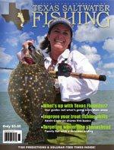
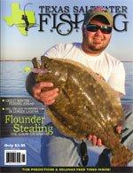
Flounder in the News
Year of the flounder
Tighter regulations and stocking combine to help Texas flounder
Caller Times, April 24, 2011
Corpus Christi, Texas
Perfect storm for flounder
Texas flounder population doubles as interest, research, funding and regulation changes contribute to recovery
Caller Times, July 10, 2011
Corpus Christi, Texas
Flounder no longer floundering in Texas
Tightened bag limits foster better recruitment and happier anglers
Houston Chronicle, Nov 7, 2012
Houston, Texas

Slide 20
Status of Spotted Seatrout (SST) Along the Texas Coast

Slide 21
SST Regulation History
1978 – 12” size limit; 20 fish bag limit
1980 – Monofilament gill nets banned
1981 – Sale of red drum and spotted seatrout banned
1984 – 14” size limit; 10 fish bag limit
1988 – Total ban on entangling nets
1990 – 15” size limit
2002 – Eliminated charter captain and crew limit; bag limit of fish >25” reduced to 1 per day

Slide 22
Current SST Regulations
10 fish daily bag
15” minimum size
One over 25” per person per day, counts as part of daily bag
Special regulation for the LLM (2007)
  Reduced bag limit to 5 fish
  Possession limit equals bag limit

Slide 23
Coastwide Landings
Number

Slide 24
Coastwide Gill Nets
Number per hour

Slide 25
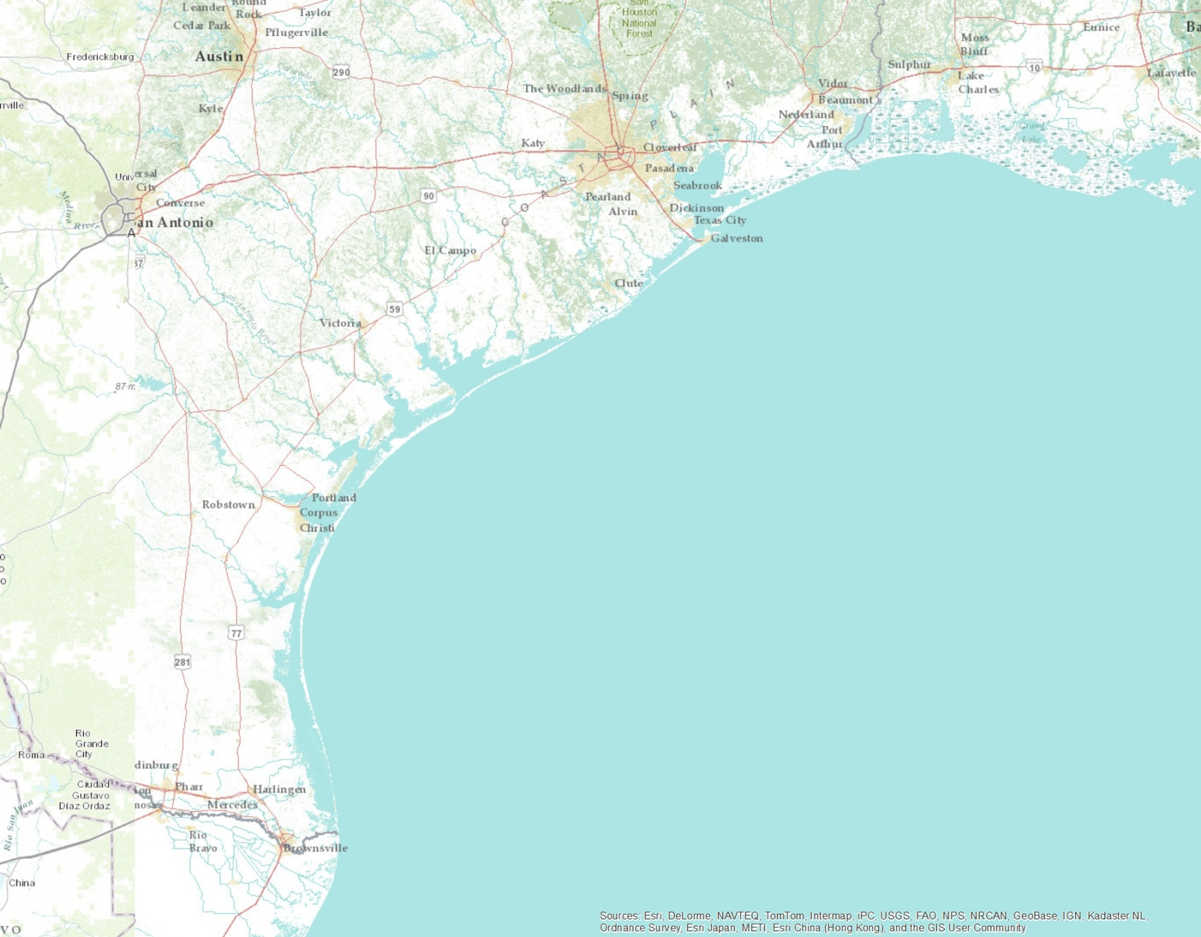
Texas Coastal Regions
Upper Coast
Middle Coast
Lower Coast
Lower Laguna Madre

Slide 26
Spring Gill Nets by Region
Number per hour

Slide 27
Coastwide June-Nov Bag Seines
Catch per Hectare

Slide 28
June-November Bag Seines by Region
Catch per Hectare

Slide 29
Private Boat Trips Landing Spotted Seatrout by Region

Slide 30
2012 Coastwide Length Frequency

Slide 31
2012 Coastwide Bag Distribution
Excluding the lower Laguna Madre

Slide 32
Bay Private Boats Trip Satisfaction by Region
Mean Trip Score

Slide 33
Lower Laguna Madre Gill Net Catch Rate
Number per hour

Slide 34
Lower Laguna Madre Recreational Landings
Number

Slide 35
Status of Spotted Seatrout
2011 landings (private + party) are the 2nd highest on record
Spring 2013 CPUE 5th highest on record
All bays reported average to above-average gill net cpue
Recent gains are from four years of strong juvenile recruitment
Bag seines reflect strong recruitment

