Slide 1
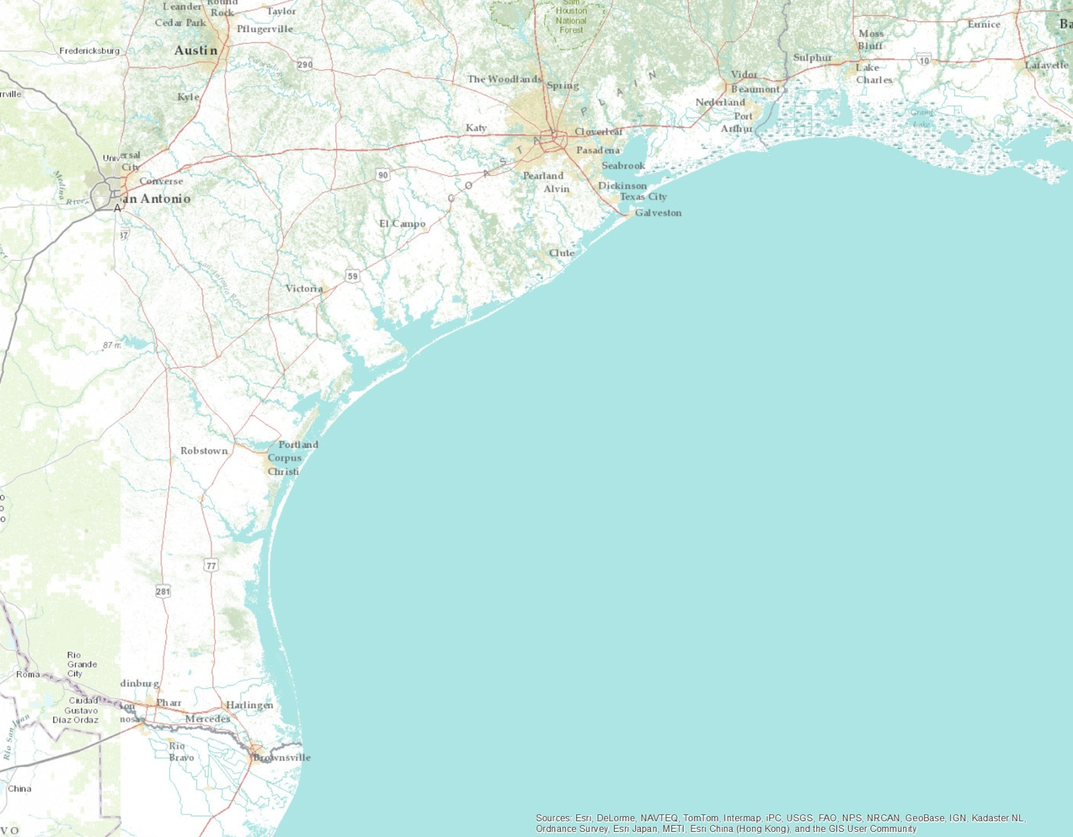
Texas Coastal Regions
Upper Coast
Middle Coast
Lower Coast
Lower Laguna Madre

Slide 2
Coastwide Gill Nets Flounder
Number per Hour

Slide 3
Coastwide Gill Nets Trout
Number per hour

Slide 4
Spring Gill Nets by Region
Number per hour

Slide 5
Coastwide June-Nov Bag Seines
Catch per Hectare

Slide 6
June-November Bag Seines by Region
Catch per Hectare

Slide 7
Status of Spotted Seatrout
2011 landings (private + party) are the 2nd highest on record
Spring 2013 CPUE 5th highest on record
All bays reported average to above-average gill net cpue
Recent gains are from four years of strong juvenile recruitment
Bag seines reflect strong recruitment

Slide 8
Spring Gill Nets by Region
Number per hour

Slide 9
Spring Gill Nets by Region 6 years before/after reductions
Number per hour

Slide 10
Spring Gill Nets LLM 6 years Before/After
Number per hour

Slide 11
Coastwide June-Nov Bag Seines
Catch per Hectare

Slide 12
June-November Bag Seines by Region
Catch per Hectare

Slide 13
June-November Bag Seines by Region since 2007
Catch per Hectare

Slide 14
Lower Laguna Madre Spotted Seatrout Bag Distribution
Private boats, 2004-2012; Regulation implemented Sept 1, 2007

Slide 15
2012 Lower Laguna Madre Bag Distribution

Slide 16
2012 Coastwide Bag Distribution
Excluding the lower Laguna Madre

Slide 17
Lower Laguna Madre Spotted Seatrout Bag Distribution
Private boats, 2004-2012; Regulation implemented Sept 1, 2007

Slide 18
Mean Length of Spotted Seatrout Landed by Anglers
Notes:
Upper=Sabine, Galveston, Cedar Lakes, East Matagorda; Middle=West Matagorda, San Antonio, Aransas; Lower=Corpus, upper Laguna

Slide 19
Mean Length of Spotted Seatrout Landed by Anglers 2001-2012
Notes:
Upper=Sabine, Galveston, Cedar Lakes, East Matagorda; Middle=West Matagorda, San Antonio, Aransas; Lower=Corpus, upper Laguna

